Slide 1
Home/Index Template
Click to start presentation

Slide 2




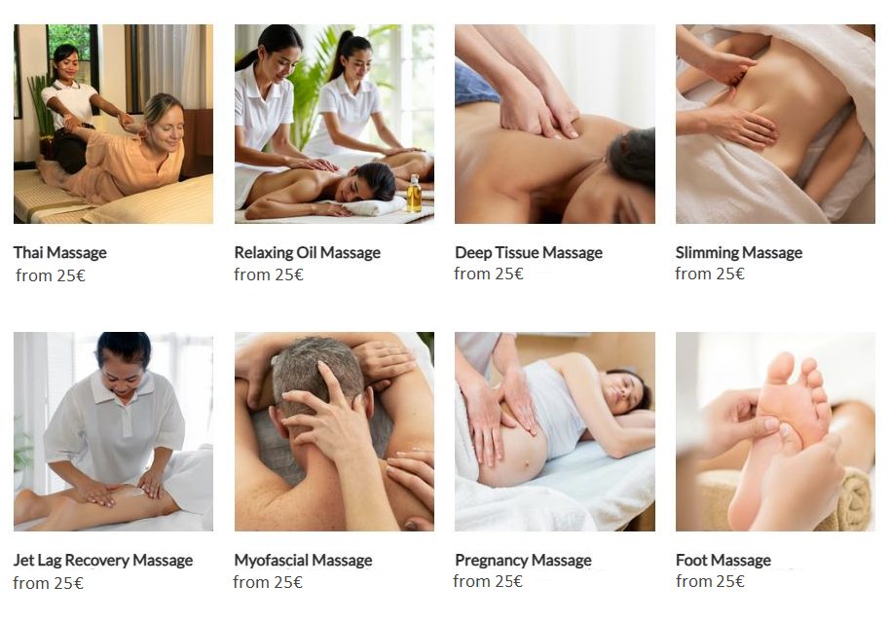
Home
Bookings
About us
Services
Contacts
Profile
Join us
Sign in
Germany Mobile Spa
Germany
Berlin
Thai Massage
Relax. Rejuvenate. Renew.
Discover the healing power of touch. Our expert massage therapies not only melt away stress but also improve circulation, relieve muscle tension, and promote overall well-being. Invest in your health —because you deserve it.
Find closest therapist

Slide 3


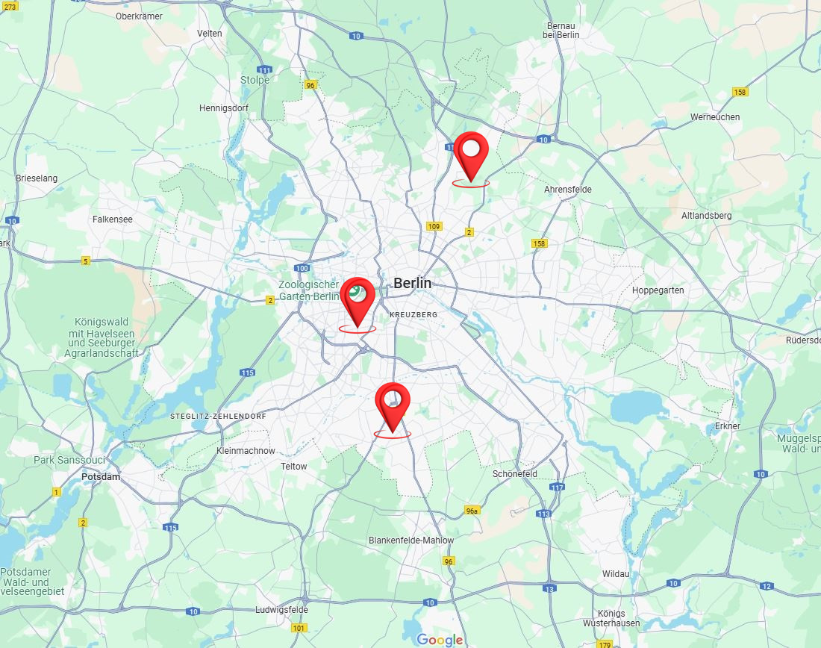
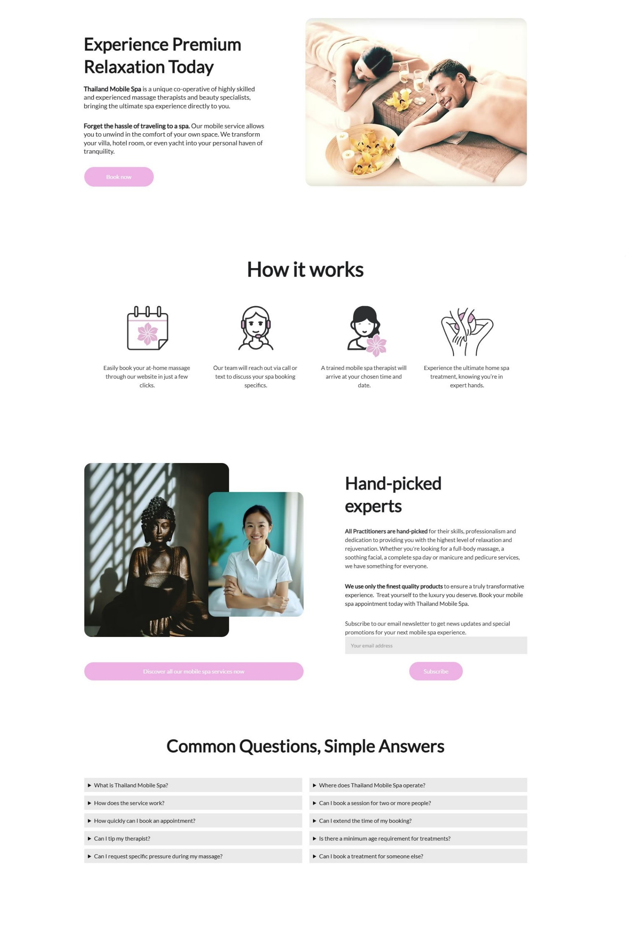
Enter your address
Germany
Berlin
Thai Massage
Continue
Home
Bookings
About us
Services
Contacts
Profile
Join us
Sign in
Germany Mobile Spa
Germany Mobile Spa

Slide 4
Home
Bookings
About us
Services
Contacts
Profile
Join us
Sign in
Germany Mobile Spa

Slide 5
Home
Bookings
About us
Services
Contacts
Profile
Join us
Sign in
Germany Mobile Spa
What is Germany Mobile Spa?
Where does Thailand Mobile Spa operate?
What is Germany Mobile Spa?
Where does Thailand Mobile Spa operate?

Slide 6
Home
Bookings
About us
Services
Contacts
Profile
Join us
Sign in
Germany Mobile Spa
What is Germany Mobile Spa?
Where does Thailand Mobile Spa operate?
Discover the Benefits of Massage Therapy:
Relieves stress and anxiety
Eases muscle tension and pain
Improves circulation and flexibility
Boosts immune function and mental clarity
Why Choose Us? At [Your Business Name], we combine skill, care, and a serene environment to provide you with the ultimate relaxation experience. Our certified therapists customize each session to your needs, helping you unwind, rejuvenate, and restore balance.
Rechtliches
Impressum Datenschutzerklärung Einwilligungen widerrufen Historie der Privatsphäre-Einstellungen Privatsphäre-Einstellungen ändern
float HafenCity
Am Kaiserkai 42 20457 Hamburg Tel: 040 / 70 38 37 30 hafencity@float-hamburg.com
tägl. 10:00 – 22:00 Uhr
float Neustadt
Alter Steinweg 1 20459 Hamburg Tel: 040 / 36 93 54 64 neustadt@float-hamburg.com
tägl. 10:00 – 22:00 Uhr
float Rotherbaum
Mittelweg 160 20148 Hamburg Tel: 040 / 21 00 69 89 rotherbaum@float-hamburg.com
tägl. 10:00 – 22:00 Uhr
© 2024 [Your Business Name]. All rights reserved.
Follow us: [Social Media Icons]

Slide 7

Relax. Rejuvenate. Renew.
Discover the healing power of touch. Our expert massage therapies not only melt away stress but also improve circulation, relieve muscle tension, and promote overall well-being. Invest in your health —because you deserve it.
What is Germany Mobile Spa?
Where does Thailand Mobile Spa operate?
Find your closest therapist
Home
Bookings
About us
Services
Contacts
Profile
Join us
Sign in
Germany Mobile Spa
Discover the Benefits of Massage Therapy:
Relieves stress and anxiety
Eases muscle tension and pain
Improves circulation and flexibility
Boosts immune function and mental clarity
Why Choose Us? At [Your Business Name], we combine skill, care, and a serene environment to provide you with the ultimate relaxation experience. Our certified therapists customize each session to your needs, helping you unwind, rejuvenate, and restore balance.
Rechtliches
Impressum Datenschutzerklärung Einwilligungen widerrufen Historie der Privatsphäre-Einstellungen Privatsphäre-Einstellungen ändern
float HafenCity
Am Kaiserkai 42 20457 Hamburg Tel: 040 / 70 38 37 30 hafencity@float-hamburg.com
tägl. 10:00 – 22:00 Uhr
float Neustadt
Alter Steinweg 1 20459 Hamburg Tel: 040 / 36 93 54 64 neustadt@float-hamburg.com
tägl. 10:00 – 22:00 Uhr
float Rotherbaum
Mittelweg 160 20148 Hamburg Tel: 040 / 21 00 69 89 rotherbaum@float-hamburg.com
tägl. 10:00 – 22:00 Uhr
© 2024 [Your Business Name]. All rights reserved.
Follow us: [Social Media Icons]

